Slide 1
Spinnaker Training Series
By OpxMx

Slide 2
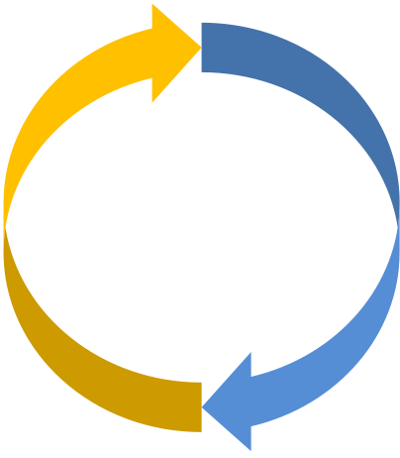
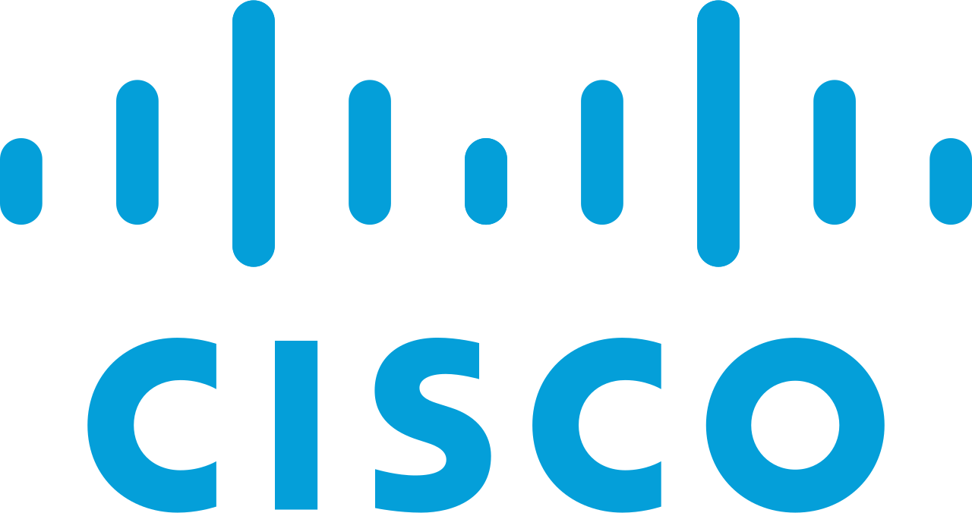



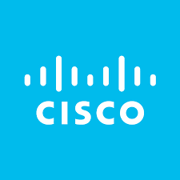

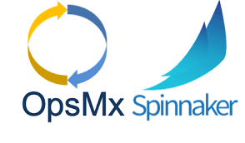
Who We Are ?
Founded
2016
Reference
Customers
Vision
Spinnaker Experts
Software delivery without human intervention.
Top-Tier
VCs
Employees Worldwide
Foundation Capital
Dell Technologies Capital
55+

Slide 3
Spinnaker
Thank You for Taking this OpsMx - Spinnaker Course
Spinnaker is the part of Delivery Pipeline, It will take care of Deployment Phase.
Spinnaker can be used in conjunction with Continuous Integration Technologies
Example : Circle CI, TravisCI, Jenkins, BitBucket, TeamCity…
Spinnaker can able to deploy and support all Major Cloud Providers
AWS, GCP, Azure, App Engine, Kubernetes, etc..

Slide 4
Course Objective
To be able to use Spinnaker
To Get familiar with Continuous deployment ecosystem.
To Setup Continuous deployment platform using
Jenkins
AWS
Kubernetes
To Create Pipelines in Spinnaker to Deploy in Various Platforms
Deploy Spinnaker in an Enterprise Environment.

Slide 5
Course Overview
Introduction | Deployment To AWS | Building Pipelines | Deploy to Kubernetes
What is Spinnaker and its History | Add Provider | Stage Types | Containers
Spinnaker Example | Pipeline Using AWS | Manual Decision | v1 and v2 Deployments
Why Should I Use Spinnaker | Immutable Infrastructure | Rollback | v2 pipeline
Installation | Build Debian File | Notification | Manifest From Artifacts
Concept | Baking AMIs | Canary Deployment | Build Automation with Webhooks
Providers
Deployment Strategies
Pipeline

Slide 6
Course Content - Download
GIT URL - https://github.com/OpsMx/OpsMx-Spinnaker-Tutorial.git
Blog URL - https://blog.opsmx.com/
Slack Support - spinnakerteam.slack.com
E-Mail - hello@opsmx.com

Slide 7
Thank You :)

